Slide 1
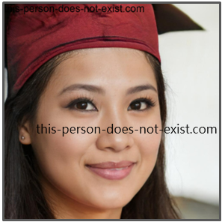
"Through determination and a vision for a brighter future, I'm navigating life's challenges, one step at a time, for the sake of my child and my dreams."
Goals
Establish her Amazon e-commerce business as a newcomer.
Achieve financial independence to support herself and her child.
Build a brand that aligns with her values and provides a stable future.
Frustrations
Limited experience in e-commerce and Amazon selling.
Challenges due to her low vision in managing the business effectively.
Lack of a Chinese version of the app to access resources in her preferred language.
Yu Li
Age:
Education:
Hometown:
Family:
Occupation:
34
Bachelor's degree
Yiwu, China
Daughter
Aspiring entrepreneur and Amazon seller
Yu Li's user journey begins with her desire to secure a better future for herself and her child through e-commerce. As a newcomer, she faces challenges navigating Amazon's complexities and managing her business, compounded by her low vision. Yu Li actively seeks accessible tools, including a Chinese version of the app, to overcome these hurdles and pursue her entrepreneurial dreams.

Slide 2
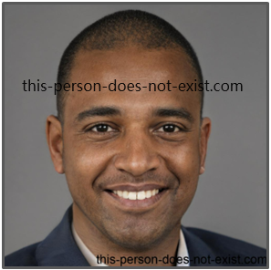
“Promoting diversity is not just a passion; it's my purpose. Through e-commerce, I'm painting the world with inclusivity, one product at a time.”
Goals
Expand his successful e-commerce business as an experienced seller.
Promote diverse and inclusive products that celebrate underrepresented voices.
Advocate for LGBTQ+ and diversity causes through his business.
Frustrations
Challenges in scaling the business and effectively managing inventory.
Difficulty finding suppliers and manufacturers that align with his values of diversity and inclusion.
Crafting marketing strategies tailored to his specific target audience poses a unique challenge.
John Brown
Age:
Education:
Hometown:
Family:
Occupation:
28
High school graduate
New York
parents, siblings
Experienced Amazon seller, entrepreneur
Danny's user journey begins with his transition from a corporate career to successful Amazon entrepreneurship. Despite his experience, he grapples with scaling the business and ensuring his commitment to inclusivity and diversity is maintained. Danny actively seeks innovative solutions to effectively manage inventory, connect with suppliers who share his values, and develop marketing strategies that resonate with his diverse target audience.

